Slide 1
Fake News Detection using Python and Machine Learning
B.Maheswar

Slide 2
What is Fake News?
The fundamental definition of fake news is information that leads people wrong. Now a days, fake news spreads like wildfire, and people share it without confirming it. This is frequently done to advance or enforce specific beliefs and is frequently accomplished through political agendas.
The ability to draw users to media organizations' websites is required to create online advertising revenue. As a result, it is vital to recognize fake news.

Slide 3
How to Design a Fake News Detection System?
To create a Fake news detection system and to make the system functional, python provides a bunch of libraries.
Libraries we use are:
Pandas
Numpy
Seaborn
Matplotlib
Sklearn
train_test_split()
Accuray_score
Classification report
Re
string

Slide 4
Functionality of the Libraries
Pandas:
To create a Fake news detection system and to make the system functional, python provides a bunch of libraries. To understand how to create a system using python and make it functional for the Fake News detection system.
Numpy:
The Python package NumPy is used to manipulate arrays.Additionally, it has matrices, Fourier transform, and functions for working in the area of linear algebra.
Seaborn:
A package called Seaborn uses Matplotlib as its foundation to plot graphs. In order to see random distributions, it will be used.

Slide 5
Functionality of the Libraries
Matplotlib:
For the Python programming language & its NumPy numerical mathematics add-on, Matplotlib is a graphing library. It offers an object-oriented API for integrating charts into programs utilizing all-purpose GUI toolkits like Tkinter, wxPython, Qt, or GTK.
Sklearn:
It includes a variety of classification, regression, and clustering methods, such as support vector machines, random forests, gradient boosting, k-means, and DBSCAN, and is built to work with Python's NumPy and SciPy scientific and numerical libraries.
train_test_split():
Machine learning algorithms applicable to prediction-based algorithms and applications are evaluated using the train-test split. We can compare the output of our own machine-learning model to that of other machines using this quick and simple process.

Slide 6
Functionality of the Libraries
Accuracy_score:
This function computes subset accuracy in multilabel classification: the set of labels predicted for a sample must exactly match the corresponding set of labels in y true.
Cassification_report:
A classification report is used to assess the accuracy of a classification algorithm predictions. How many predictions are correct and how many are incorrect? True Positives, False Positives, True Negatives, and False Negatives are specifically utilized to predict the metrics of a classification report.
Re:
The functions in this module allow you to determine whether a given text fits a given regular expression, known as a regular expression.

Slide 7
Functionality of the Libraries
String:
You can use the Python library NLTK, or Natural Language Toolkit, for NLP. A large portion of the data you might be examining is unstructured and contains text humans can read. Preprocessing that data is necessary before you can programmatically evaluate it.

Slide 8
Logistic regression
Logistic regression is a supervised classification model known as the logit model. It estimates the probability of something occurring, like 'will buy' or 'will not buy,' based on a dataset of independent variables. The outcome should be a categorical or a discrete value.
Is also data analysis technique that uses mathematics to find the relationships between two data factors. It then uses this relationship to predict the value of one of those factors based on the other. The prediction usually has a finite number of outcomes, like yes or no.

Slide 9
Linear regression
Linear regression is defined as the process of determining the straight line that best fits a set of dispersed data points: The line can then be projected to forecast fresh data points. Because of its simplicity and essential features, linear regression is a fundamental Machine Learning method.
Linear regression is a statistical method for modeling relationships between a dependent variable with a given set of independent variables.

Slide 10
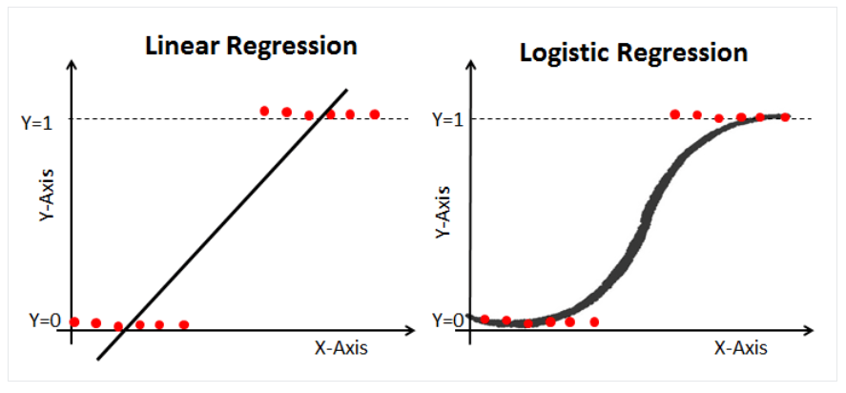

Slide 11

Decision Tree
Decision Trees (DTs) are a non-parametric supervised learning method used for classification and regression. A decision tree is a flowchart-like tree structure where an internal node represents a feature(or attribute), the branch represents a decision rule, and each leaf node represents the outcome. The topmost node in a decision tree is known as the root node. It learns to partition on the basis of the attribute value.

Slide 12
Fake news detection design
Steps involved in the design:
Step 1: Importing Libraries.
Step 2: Importing the Dataset.
Step 3: Assigning Classes to the Dataset.
Step 4: Checking number of rows and columns in the Dataset.
Step 5: Manual Testing for both the Dataset.
Step 6: Assigning classes to the Dataset.
Step 7: Merging both the Dataset.
Step 8: Dropping Unwanted Columns.

Slide 13
Fake news detection design
Step 9: Create a Function to clean Text.
Step 10: Applying Function to text column and assigning X and Y.
Step 11: Defining Training and Testing Data and Splitting them into &5-25 Percent Ratio.
Step 12: Converting Raw Data into Matrix for further process.
Step 13: Creating first Model.
Step 14: Checking the model Accuracy and Classification Report.
Step 15: Creating a Second Model.
Step 16: Checking the model Accuracy and Classification Report.
Step 17: Checking Fake News.

Slide 14
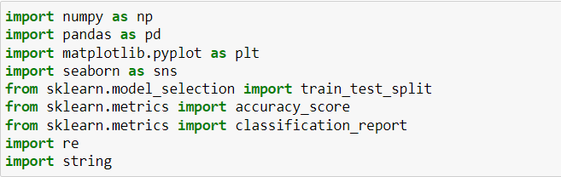
Importing Libraries.

Slide 15
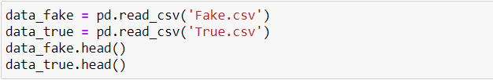
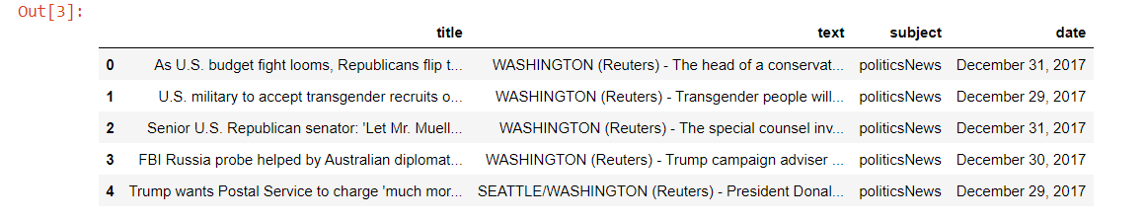
Importing the Dataset.

Slide 16



Assigning Classes to the Dataset.
Checking number of rows and columns in the Dataset.
Shape: Using the shape function we can check how many rows and columns are present in the dataset.

Slide 17
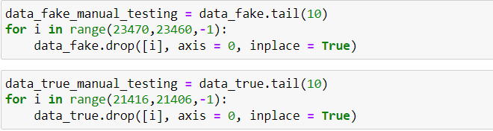
Manual Testing for both the Dataset
Manual Testing: The process of manually checking software for faults is known as manual testing. It requires a tester to act like an end user, using the majority of the application's capabilities to ensure proper behavior.

Slide 18

Assigning classes to the Dataset.
Merging both the datasets
Dropping Unwanted Columns.
Drop: The drop() function deletes the given row or column. The drop() method eliminates the selected column by specifying the column axis (axis='columns').

Slide 19
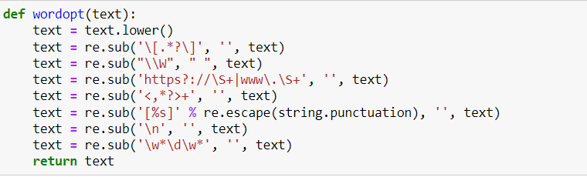
Create a Function to clean Text
re.sub(): The Python Regular Expressions (re) module contains the sub() method. All instances of the supplied pattern that match are replaced by the replace string in the returned string. We must import the re-module first before we can utilize this function.

Slide 20
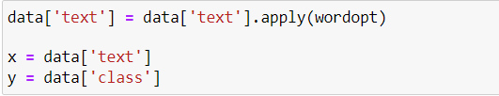
Applying Function to text column and assigning X and Y
Defining Training and Testing Data and Splitting them into &5-25 Percent Ratio

Slide 21
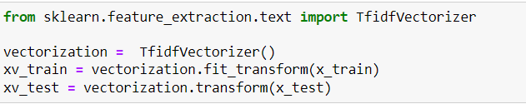
Converting Raw Data into Matrix for further process
TfidVectorizer: The TfidfVectorizer turns a set of raw documents into a TF-IDF feature matrix. Python implementation of Us with and Word2Vec word embeddings.
Fit_transform: It is used to train data in order to scale it and learn the scaling parameters.

Slide 22
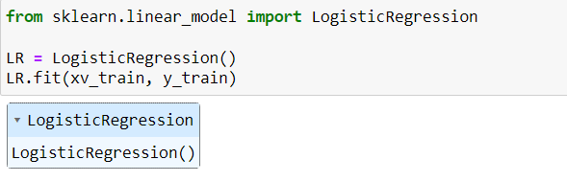
Creating first Model
LogisticRegression: Based on a collection of independent variables, logistic regression assesses the likelihood of an event occurring, such as voting or not voting. Because the outcome is a probability, the dependent variable is limited to values between 0 and 1.
LR.fit: Linear regression fits a line to the data in order to predict a new quantity, whereas logistic regression fits a line in order to optimally distinguish the two classes. The input data is given by X with n examples, and the output by y with one output for each input.

Slide 23
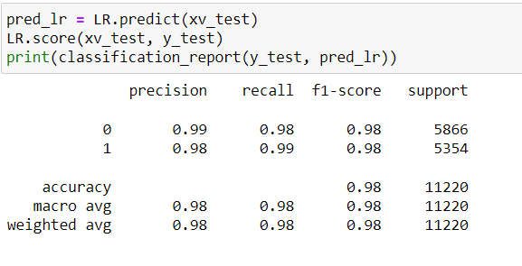
Checking the model Accuracy and Classification Report.

Slide 24
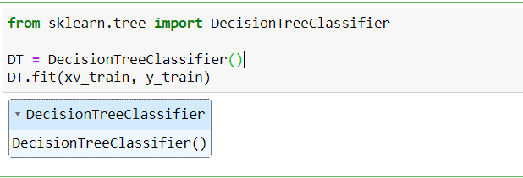
Creating a Second Model
DecisionTreeClassifier: The DecisionTreeClassifier class may conduct multi-class classification on a dataset. If numerous classes have the same and highest probability, the classifier will forecast the class with the lowest index among those classes.

Slide 25
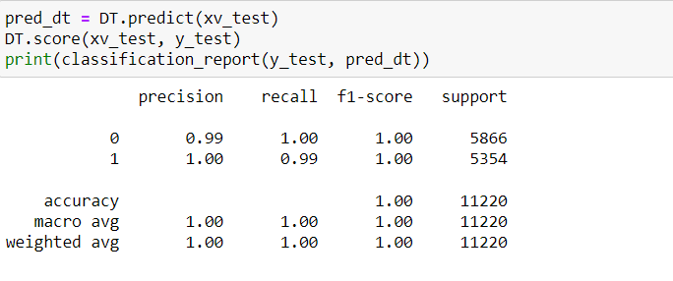
Checking the model Accuracy and Classification Report.

Slide 26
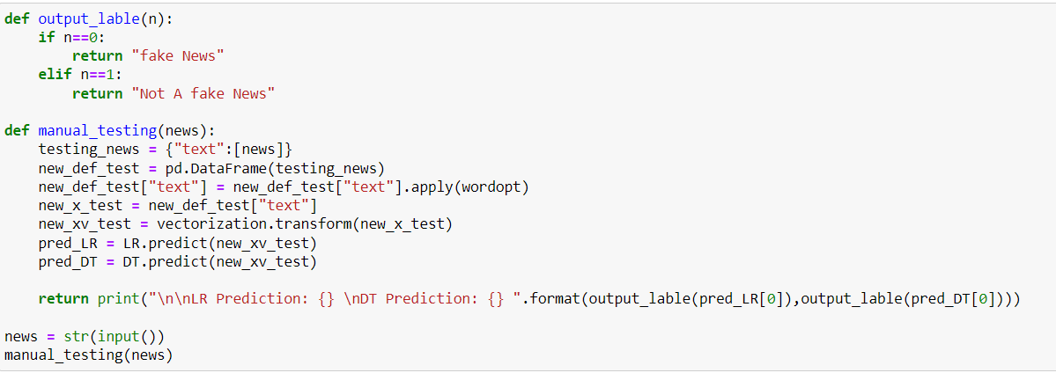
Checking Fake News.

Slide 27
Conclusion
Let me show you the working system which can detect the Fake news.
Thanks for providing a chance to display my project

